Slide 1
Spring MVC Framework
Java Center of Excellence

Slide 2
Objectives
History
Existing Frameworks
Need for Spring
Basic Request Flow
MVC Architecture
Few Examples
Notes:
For different experience, people will have different expectations. At the beginning of the training itself, it is recommended that the expectations are made clear:
Beginner resources will find most of this very new and heavy
Experienced resources may already be familiar with some or many of these concepts

Slide 3
Where we’ve been
Web based programming “The Servlet Way”
JSP or HTML Form → Submit to servlet → Servlet Processes data & Outputs information
Works well for small applications but can quickly grow out of control because HTML, scrip-lets, java script, tag-libraries, database access, and business logic makes it difficult to organize.
Put simply, lack of structure can cause a “soup” of different technologies.
JSP’s compile to Servlet

Slide 4
“A Better Way?”
Separate the Data Access, Business Logic and Presentation using a M.V.C. Framework.
Choose a M.V.C. framework:
WebWork, Spring, Struts, Java-Server-Faces, Tapestry plus “many more”

Slide 5
Things change:
Struts, by far is the most popular; same creator of Struts (Craig McClanahan) is the co-spec leader of Java Server Faces.
Webwork evolved to Webwork2
Tapestry - has been around for awhile.
Spring – “newer” of the frameworks. Integrates well with any other framework or by itself.

Slide 6
Why use Spring?
All frameworks integrate well with Spring.
Spring offers an open yet structured framework, using dependency-injection, a type of inversion-of-control to integrate different technologies together.
Consistent Configuration, open plug-in architecture
Integrates well with different O/R Mapping frameworks like Hibernate
Easier to test applications with.
Less complicated then other frameworks.
Active user community, many new books coming out.

Slide 7
Want to integrate your existing web-app with a
Spring middle tier?
  Struts
    http://struts.sourceforge.net/struts-spring/
  Web Work
    http://wiki.opensymphony.com/space/Spring+Framework+Integration
  Tapestry
    http://www.springframework.org/docs/integration/tapestry.html

Slide 8
What if I like Microsoft .NET?
Then try Spring Framework .NET
http://sourceforge.net/projects/springnet/

Slide 9
About Spring MVC
Comes with the Spring distribution
Well integrated with the rest of Spring
Very extensible

Slide 10
Quick Spring Refresher
Write dependencies as setters
Link up dependencies in XML file
The Spring Framework will instantiate and call setters to hook it all together
<bean id=“dateFormat" class=“java.text.SimpleDateFormat">
<constructor-arg value=“dd MMM yyyy”/>
</bean>
<bean id=“myBean" class=“com.uhc.stuff.SomeClass">
<property name=“dateFormat” ref=“dateFormat”/>
</bean>

Slide 11
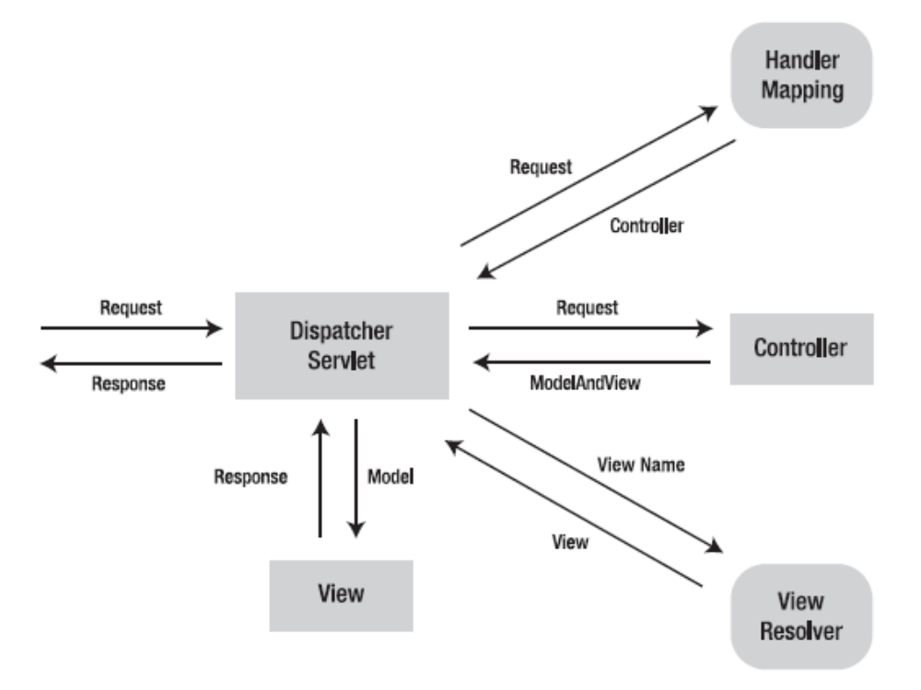
Basic Request Flow

Slide 12
Spring Web Controllers
In an MVC architecture your controllers handle all requests.
Spring uses a ‘DispatcherServlet” defined in the web.xml file to analyze a request URL pattern and then pass control to the correct Controller by using a URL mapping defined in a “ Spring bean” XML file.

Slide 13
Request Flow
When a request is sent to the Spring MVC Framework the
following sequence of events happen.
  The DispatcherServlet first receives the request.
  The DispatcherServlet consults the HandlerMapping and invokes the Controller associated with the request.
  The Controller process the request by calling the appropriate service methods and returns a ModeAndView object to the DispatcherServlet. The ModeAndView object contains the model data and the view name.
  The DispatcherServlet sends the view name to a ViewResolver to find the actual View to invoke.
  Now the DispatcherServlet will pass the model object to the View to render the result.
  The View with the help of the model data will render the result back to the user.

Slide 14
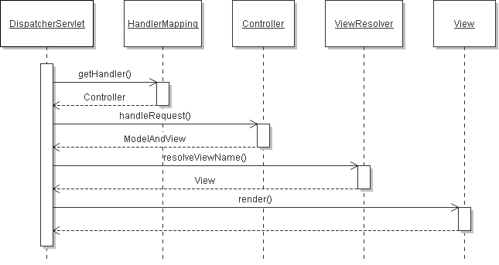
Spring MVC (Sequence Diagram)

Slide 15
Practicals - Spring Web Container Setup
In your Web Container, the Spring “bean” XML file exists in the same directory as your web.xml file with a “-servlet.xml” appended to it.
webapps
/uhgapp
/WEB-INF/uhgapp-servlet.xml, web.xml)
/classes
/lib (all jar files)
The dispatcher servlet is mapped to the name “uhgapp” so it knows to look in the “uhgapp-servlet.xml” file to look-up a URL-to- Controller match.

Slide 16
Example of web.xml file
<web-app>
<servlet>
<servlet-name>uhgapp</servlet-name>
<servlet-class>DispatcherServlet</servlet-class>
</servlet>
<servlet-mapping>
<servlet-name>uhgapp</servlet-name>
<url-pattern>*.htm</url-pattern>
</servlet-mapping>
</web-app>
*** Any URL ending with an “.htm” pattern is routed to the DispatcherServlet, the DispatcherServlet loads the uhgapp-servlet.xml file and routes the user to the correct controller.

Slide 17
Exercise
Setup Machines for Spring MVC
  create a web app skeleton
  add build files
  add required JARs
  (Refer Word Doc)

Slide 18
An Example- Hello World
Steps
Spring Servlet Declaration
Spring Servlet Configuration
Controller
View
Make it work

Slide 19
Spring Servlet Declaration
In 'WEB-INF/web.xml', we declare Spring DispatcherServlet and map '*.html' URLs to it:
<servlet>
<servlet-name>springmvc</servlet-name>
<servlet-class>org.springframework.web.servlet.DispatcherServlet</servlet-class>
<load-on-startup>1</load-on-startup>
</servlet>
<servlet-mapping>
<servlet-name>springmvc</servlet-name>
<url-pattern>*.html</url-pattern>
</servlet-mapping>

Slide 20
Spring Servlet Configuration
Create the Spring configuration file 'WEB-INF/springmvc-servlet.xml' (name based on the servlet name above):
Map URL /hello_world.html to Controller HelloWorldController
Declare View Resolver: when view 'view_name' is called (from the Controller), the file '/jsp/view_name.jsp' will be used.
<bean name="/hello_world.html" class="springmvc.web.HelloWorldController"/>
<bean id="viewResolver" class="org.springframework.web.servlet.view.InternalResourceViewResolver">
<property name="viewClass" value="org.springframework.web.servlet.view.JstlView"/>
<property name="prefix" value="/jsp/"/>
<property name="suffix" value=".jsp"/>
</bean>

Slide 21
Controller
Create the Controller 'WEB-INF/src/springmvc/web/HelloWorldController.java':
public class HelloWorldController implements Controller {
public ModelAndView handleRequest(HttpServletRequest request,
HttpServletResponse response) throws ServletException, IOException {
String aMessage = "Hello World MVC!";
ModelAndView modelAndView = new ModelAndView("hello_world");
modelAndView.addObject("message", aMessage);
return modelAndView;
}
}

Slide 22
View
Now the view: 'jsp/hello_world.jsp':
Displays the message attribute previously set in the Controller.
<%@ taglib prefix="c" uri="http://java.sun.com/jsp/jstl/core" %>
<html>
<body>
<p>This is my message: ${message}</p>
</body>
</html>

Slide 23
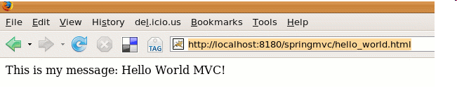
Make it work
From 'WEB-INF' folder type
ant Relaunch Tomcat and check it's working:
http://localhost:8180/springmvc/hello_world.html
(Exact port may differ)

Slide 24
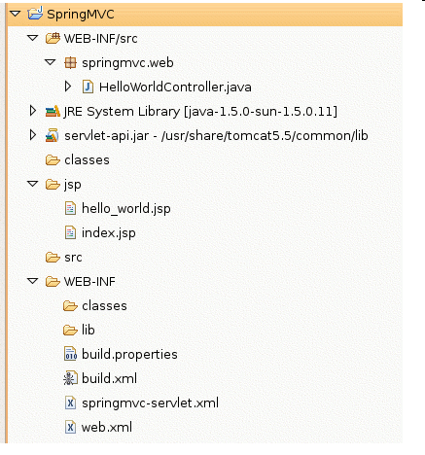
Summary
project should now look like that:

Slide 25
Hands-on Session Time

Slide 26

Model View Controller
What are we going to build?
A page displaying a car list.
We need:
Model classes: Car and Brand
Manager class: to obtain a list of Cars
Controller class: will use the list method from the Manager
View (JSP): display the car list

Slide 27
Model classes
'WEB-INF/src/springmvc/model/Brand.java'
package springmvc.model;
public class Brand {
private Long id;
private String name;
private String country;
// Getters & Setters
}

Slide 28
Model Classes
'WEB-INF/src/springmvc/model/Car.java'
package springmvc.model;
import java.math.BigDecimal;
public class Car {
private Long id;
private Brand brand;
private String model;
private BigDecimal price;
// Getters & Setters
}

Slide 29
Populate some data
'WEB-INF/src/springmvc/service/CarManager.java'
public class CarManager {
private static List<Car> carList;
static {
Brand brand1 = new Brand();
brand1.setId((long)1);
//Setters Call for cars ….
}
public List<Car> getCarList() {
return carList;
}
}

Slide 30
Controller
In 'WEB-INF/springmvc-servlet.xml', we declare a new URL:
<bean name="/list_cars.html" class="springmvc.web.CarListController"/>
public class CarListController implements Controller {
public ModelAndView handleRequest(HttpServletRequest arg0,
HttpServletResponse arg1) throws Exception {
CarManager carManager = new CarManager();
ModelAndView modelAndView = new ModelAndView("carList");
modelAndView.addObject("carList", carManager.getCarList());
return modelAndView;
}
}

Slide 31
View
The view 'carList' declared above: 'jsp/carList.jsp':
<%@ taglib prefix="c" uri="http://java.sun.com/jsp/jstl/core" %>
<html>
<body>
<h1>Car List</h1>
<c:forEach items="${carList}" var="car">
${car.brand.name} ${car.model}: ${car.price}
<br />
</c:forEach>
</body>
</html>

Slide 32
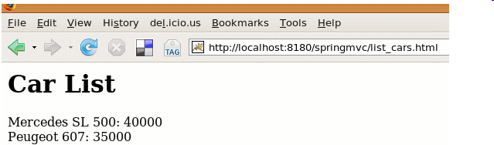
Result
Build (ant),
relaunch Tomcat
And,
check it's working: http://localhost:8180/springmvc/list_cars.html

Slide 33

Hands-on Time

Slide 34
Questions

